Slide 1
Run the Sternberg experiment
Click on the running man to start the experiment
(this will take longer than the Stroop task you ran last week)

Slide 2
Copy your data to class_share
Like last week you need to;
Find your __________trials.psydat file in the data directory (next to the experiment file)
Copy that over to the class_share folder so we can do some batch analysis for you

Slide 3
Data collection
You might be wondering why there were so many more trials this week than in the Stroop task
In some studies the thing you are measuring is quite variable between trials or between participants or both
The sources of (unwanted) variability determine how we design our experiment

Slide 4
Data collection examples
In social psychology studies there may be great variability between people and little variability within one person
e.g.
if asked your opinion on something (say, on the importance of university education) you would always give the same answer, but different people will vary a great deal
For these studies we may not need many trials, but do need many participants

Slide 5
Data collection examples
For visual ‘psychophysics’ studies, participants often vary rather little between each other (because our visual systems are very similar)
Participants do differ from trial to trial because they sometimes fail to attend and that can have a big effect on perception
For those studies, there are often few participants but they run many trials each

Slide 6
Data collection examples
For cognitive psychology experiments there is often some degree of variability both within and between participants
We may need to collect a fair number of trials per participant and collect data on many participants
If the size of the effect we are measuring is very large (as in the Stroop task) then we don’t need to work so hard to average out this ‘noise’

Slide 7
Sternberg memory task
For this task the effect size is very dependent on attention, so we need several trials
Also we want to examine 12 different conditions (6 set sizes with target absent and target present trials)
Altogether that makes 126 trials (after practice)

Slide 8
Analysing the data
Open your data file in Excel (go to the data folder and look for the file ending .xlsx)
The analysis today needs several steps (we’ll do each in detail):
filter out the data from incorrect trials
create two columns, for present and absent trials:
sort all data by the ‘present’ column
copy the bottom half of the filtered RT data up next to the top half
calculate averages according to set size
insert a chart (line chart) comparing set size with RT in the present/absent conditions

Slide 9
Excel – inspect your file
Take a look at your data file
Select the trials sheet (rather than pracTrials)
Expand the columns that you can’t see clearly
You’ll see the first 6 columns refer to the stimuli in the experiment
In this experiment each type of trial was only run once, so the resp.corr_raw should be the same as resp.corr_mean and resp.corr_std should be 0 (no variability with a single trial)
Similarly for resp.rt_xxxx columns
Notes:
Move your mouse to be just between the H and K. It will change symbol. Now you can drag the width of the cell to make the heading more visible
(alternatively select one or more columns, right-click and select column width to give multiple columns an exact width)

Slide 10
Excel – sort all data by target presence
Select all the data:
press Ctrl-A or click on the <> icon in the top left of the sheet
Sort:
Press the sort button (in the Data tab at the top)
In the dialog box make sure you’ve got Header row selected rather than No header row
Select “present” in the Sort by entry
Select “setSize” in the Then by entry (just to be sure)

Slide 11
Excel - filter out incorrect RTs
We sometimes want to filter out trials where subjects get an incorrect answer – maybe on these trials the subject was not paying attention
We can do that using the Excel function IF()
Go to cell Q2 and type
=IF(I2=1,L2,"") (or use >Insert>function… from the menus)
This means that if cell I2 is equal to 1 (correct) then Q2 will take the value of L2 (the reaction time), otherwise it will be blank (“”)
Notes:
After typing =if( notice the help tip that comes up reminding you of what the values are for this function

Slide 12

Excel - repeat for all trials
We could go down the page typing that formula for all 126 conditions
We could use copy and paste, like last week
Instead we’re going to use Excel’s auto-fill feature:
the bottom corner of the selected cell in Excel has a little square
hover your mouse over that square until it changes icon to a cross
now click and drag that cell downwards

Slide 13
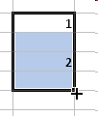
Excel – using smart fill
Smart fill can also be used to create a range of numbers:
In some area of the sheet away from your data try this out:
type 1 into a cell
type 2 just below it
select both cells (click in centre of “1” cell and drag downwards)
now click on the smart fill square on the bottom-right of these selected cells and drag down for 10 cells or so
This also works with fractions (1.1, 1.2, 1.3…)
Also with days (Monday, Tuesday…)
It can even leave periodic blanks. Try it with: 1, blank, 2, blank (select 4 cells to auto-fill, not 3)

Slide 14
Excel – create columns for present/absent
Select this new, filtered data for the target present trials (should now be grouped together Q65:Q127)
Drag this up to sit next to the target absent trials (ie drag to R2:R64):
To drag cells you need to grab the line that surrounds the selected cells. Again the mouse should change icon when you hover over it
(Type headings for these columns too, as a reminder?)

Slide 15
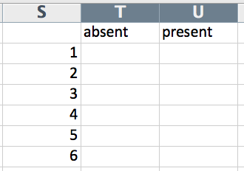
Excel – calculate averages by set size
Now you need to calculate the average RT for each of your set sizes
Create some new row/col headings like this (you might want to smart fill the range)
It might help to have the labels for setSize close to your RT data, so copy column E over unto column P

Slide 16
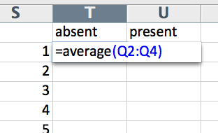
Excel – calculate averages by set size
For cell (absent,1) you need the mean of cells Q2:Q4:
go to the cell and type =average(
select the cells you want (click the centre of Q2 and drag down to Q4) or type in Q2:Q4
when you’ve selected the cells close the brackets, “)”
Selecting the cells just saves you typing the coordinates and can be done any time that a cell is needed for a function
Press return to get the average

Slide 17
Excel – repeat for the other conditions
You need to do this for the other set sizes in the ‘absent’ condition (sorry, no shortcuts this time)
We’ve used the relative references (no dollar signs) to create the means in ‘absent’
Because the equivalent ‘present’ data are lined up and one column to the right, you can now select the ‘absent’ averages and auto-fill to the right to create the ‘present’ averages ☺

Slide 18
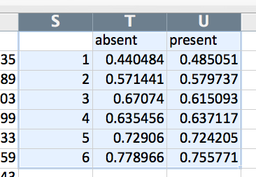
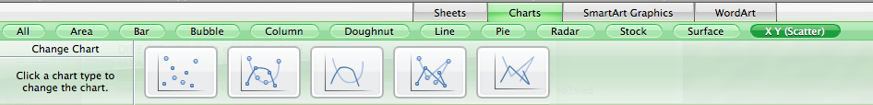
Plot a graph of your data
Select your newly analysed mean data, including the labels:
To plot that, go to the menu >Insert>Chart…
Select “X Y Scatter” to bring up the following. Select the option with the points showing and straight lines between them:

Slide 19
Compare with the predictions
Recall your predicted patterns? Which does the data look like? You may need to scale your graph so the axes are square (to match below)
Serial, self-terminate
Parallel search
Serial exhaustive
Target absent
RT
(ms)
Target present
Set size (N)
Set size (N)
Set size (N)

Slide 20
Some example (real) data

